Slide 1
REGIONAL COORDINATED COUNCIL
COMBINED
and
STEERING COMMITTEE MEETING
Regional Transportation Planning Organization and
Regional Coordinated Transportation Pilot Program
February 21, 2024

Slide 2
This meeting is being held in person at AAA9 offices, Cambridge, Ohio.
The meeting may be recorded, and if so, is recorded only in order to prepare accurate minutes.
Presentation slides and minutes will be available on the OMEGA website within one week.
This meeting is serving duly as the February RCC and Steering Committee Meeting.

Slide 3
Agenda
1. Welcome
2. Agenda
3. Roll Call
4. Regional Business:
Acceptance of Meeting Minutes
SROI Study link and Legislative Deliverable
Review of Regional Survey of Unmet Needs Data
Review of Current Top Trip Generators
Review of Regional Performance Measures
Develop Regional Unmet Needs for Coordinated Plan Revision
Review SWOT
Develop Regional SWOT for Coordinated Plan Revision
Review of Current Regional Goals
Develop Regional Goals for Coordinated Plan Revision
Review of Current Strategies/Action Items
Develop Strategies/Action Items for Coordinated Plan Revision
5. Regional Announcements and Open Roundtable For the Good of the Region
6. Adjourn

Slide 4
Roll Call
A WARM WELCOME TO OUR GUESTS AND MEMBERS!

Slide 5
Meeting Minutes
Minutes from the last RCC meeting held on
January 17, 2023,
were distributed to members prior to the meeting for their review.
Corrections?
Motion to accept?
Notes:
Are there any corrections? Motion to accept?

Slide 6
SROI Study link and Legislative Paper
Study Link:
https://omegadistrict.org/programs/transit/sroireport/
It is also available in its entirety
on the OMEGA website
www.Omegadistrict.org

Slide 7
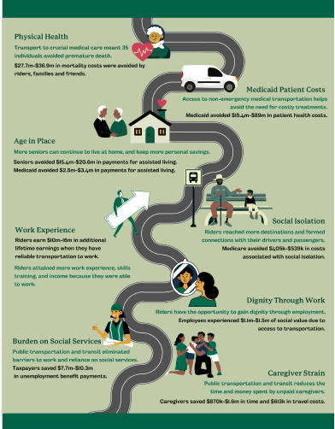
Legislative Infopage

Slide 8
Revising the Coordinated Plan

Slide 9
Regional Coordinated Plan Revision
Step One: Develop New Regional Unmet Needs
Consider Survey of Unmet Needs
Top Trip Generators
Regional Performance Measures
Current Unmet Needs List
Step Two: Develop New SWOT
Consider Current SWOT
BREAK
Step Three: Develop New Goals
Consider Current Regional Goals
Step Four: Develop Strategies for each Goal
Consider Current Strategies
Step Five: Develop Action Items for each Strategy
Consider Current Action Items

Slide 10
Step One: Develop New Regional Unmet Needs
Consider Survey of Unmet Needs
Top Trip Generators
Regional Performance Measures
Current Unmet Needs List

Slide 11
Regional Survey of Unmet Needs CY2023 Results
838 responses
Do we want to switch to a SFY instead of CY? Pros and cons. Vote.

Slide 12
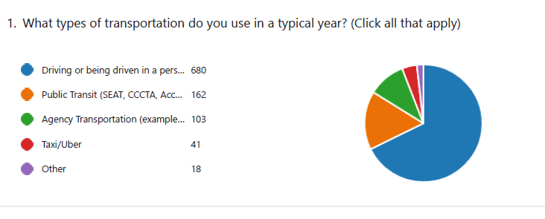

Slide 13
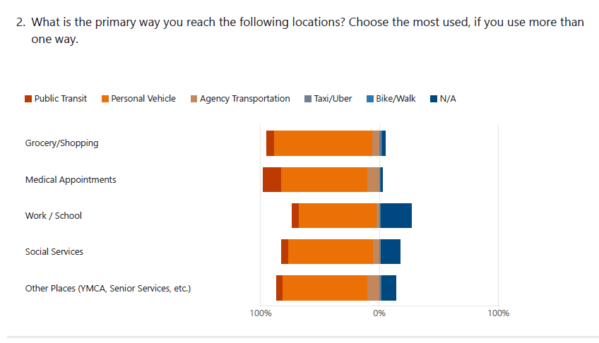

Slide 14
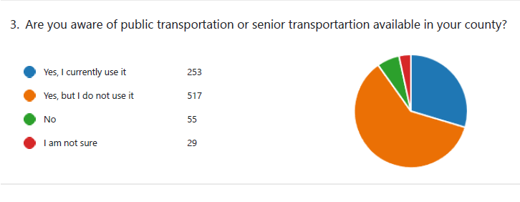

Slide 15
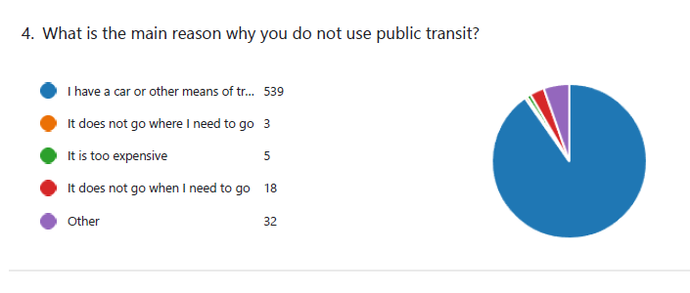
“Other” is typically that there is no public transit in their area or county.”

Slide 16
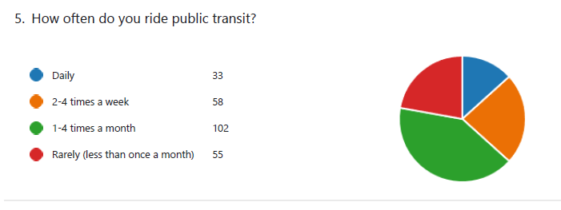
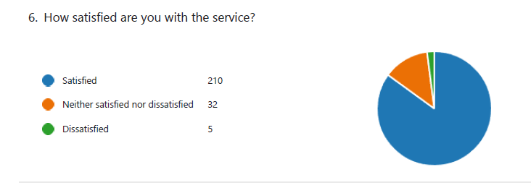

Slide 17
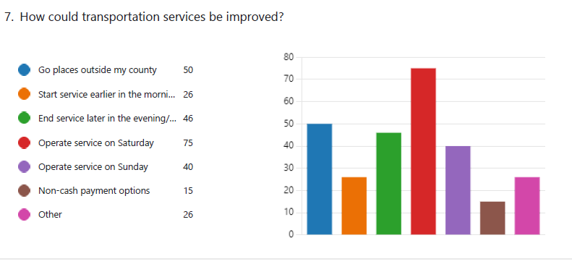

Slide 18
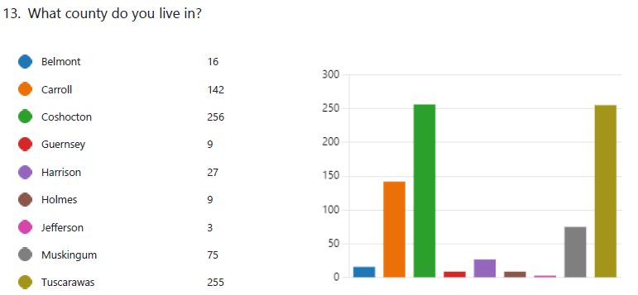

Slide 19
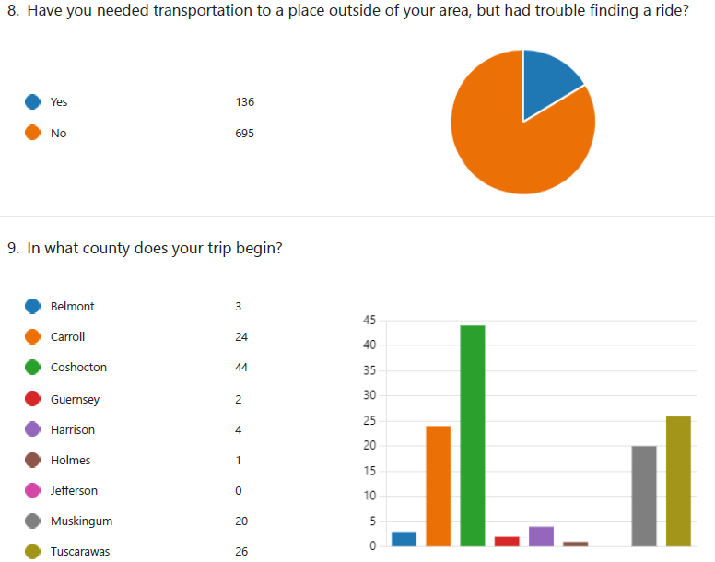

Slide 20
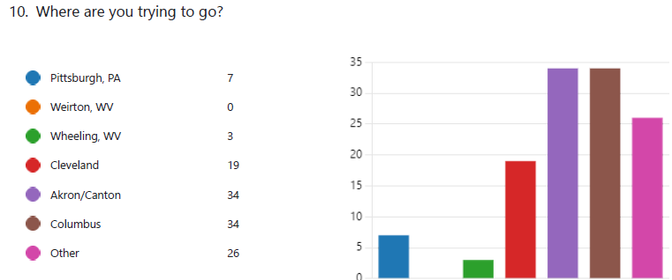

Slide 21
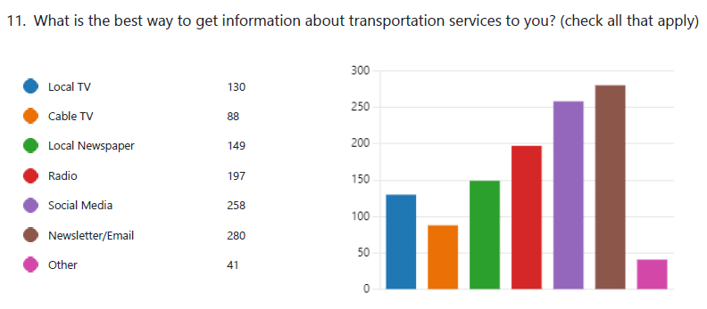

Slide 22
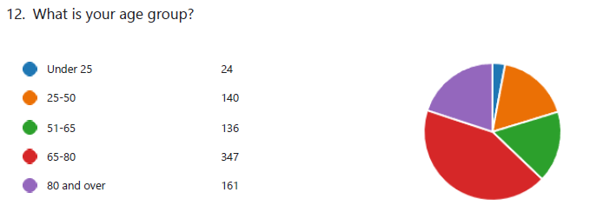
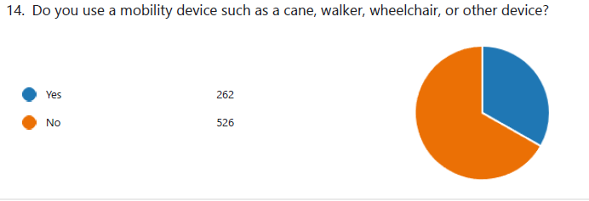
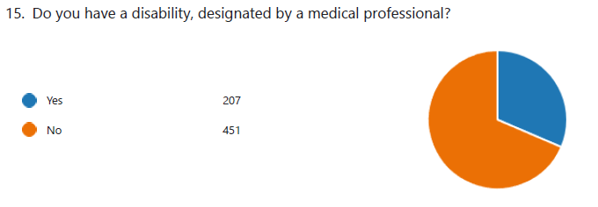

Slide 23
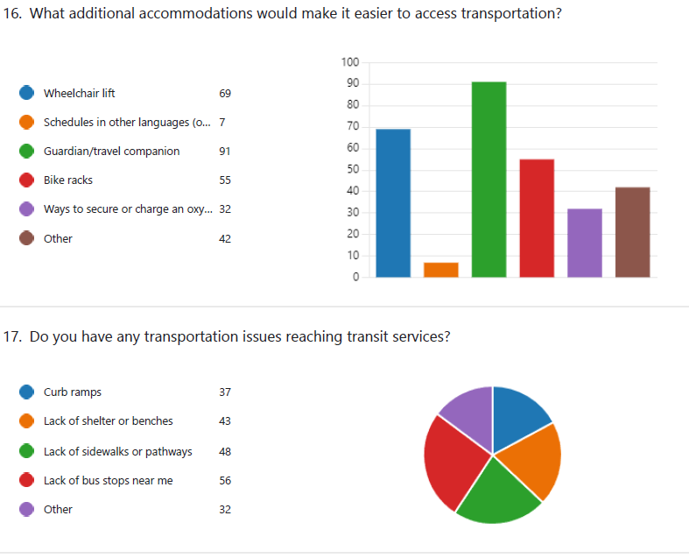
End of survey

Slide 24
Regional Trip Generators
But, trust me, it wasn’t to the beach…..

Slide 25
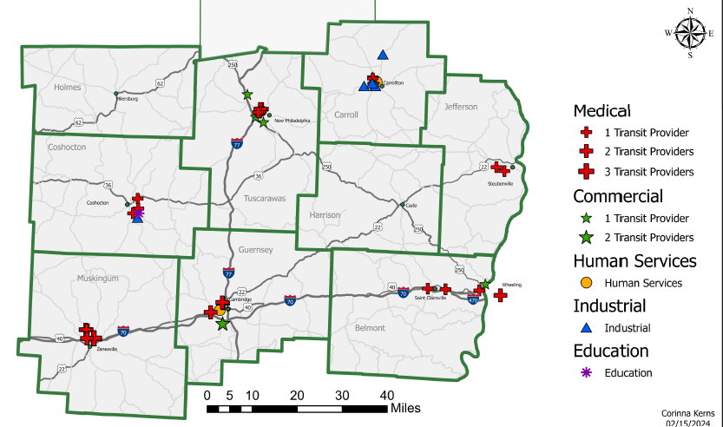
Top Five Trip Generators

Slide 26
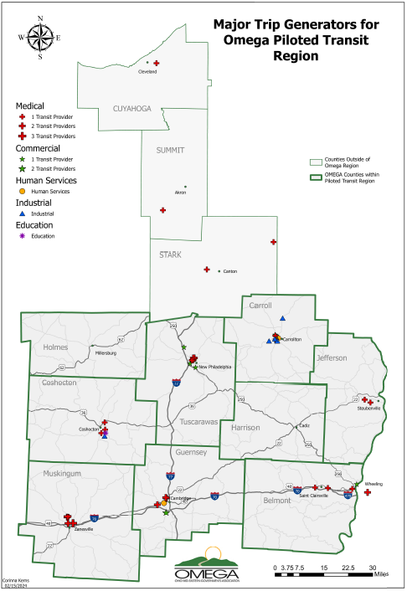

Slide 27
Trip Generators by County:
Belmont: Wheeling Hospital, Dialysis, St. Clairsville Health, Trinity Health, Kroger
Carroll: St. John’s Villa, Aultman Hospital, Discount Drug Mart, Carroll Hills Industries
Coshocton: Kidney Care, Zanesville Treatment, MVHC, Coshocton Opportunity School, Genesis Zanesville (several locations)
Guernsey: SC – in county - Senior Center, Dialysis, Walmart, Hospital/Ohio Health
SC – out of county – Genesis Hospital ( X4, 3 in Zanesville), MVHC
SEAT – Pinnacle Treatment (Methadone), MVHC, Walmart, Kidney Care
Harrison: 4 Dialysis Clinics, Wheeling Hospital (ALL out of county)
Muskingum: Genesis, Pinnacle Treatment, MVHC, Walmart, Dialysis
Tuscarawas: Access Tusc – Dialysis, Union Hospital, Aultman Hospital, Harcatus Youth Employment Services, Buehlers
SEA – Union Hospital, Aultman Hospital, Cleveland Clinic, Mercy Hospital
Tusc SC – Union Hospital, Walmart, Heritage Square (Doctors offices)
Is this a regional PROBLEM? (weakness or threat or opportunity) Is there a lack of capacity for any other type of trip including workforce because of extreme high number of medical trips which take priority?

Slide 28
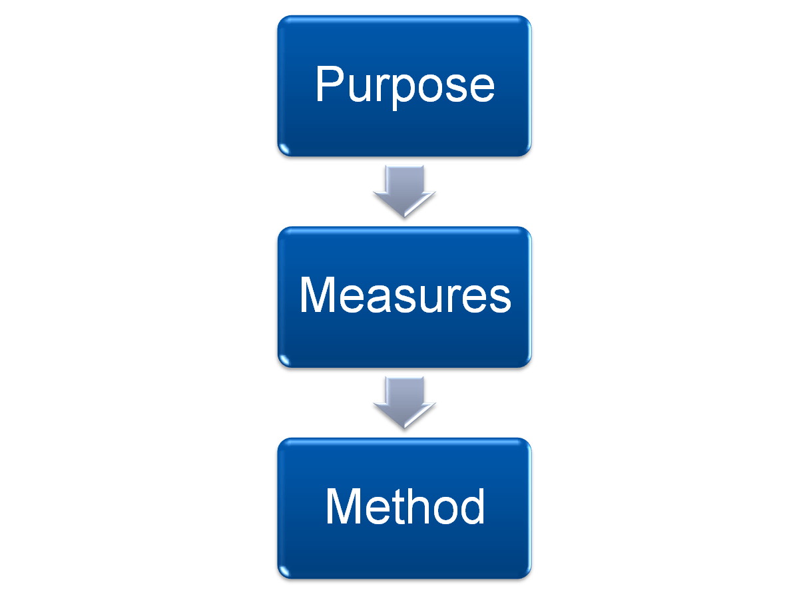
Regional Performance Measures – CY 2023 and Year-to-Year

Slide 29
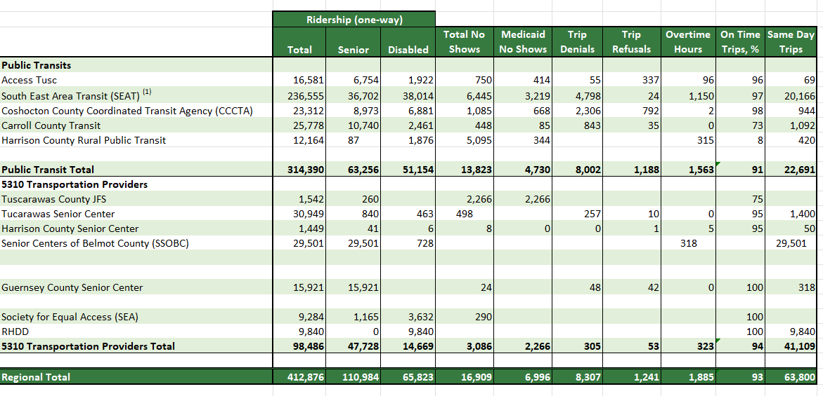
CY 2023 Regional Performance Measures
HIGH no show numbers and Medicaid is nearly 50% of all no shows regionally. Also, higher trip denials, especially SEAT and CCCTA (capacity issue?)
About 93% on time rate, regionally. Harrison rate was very low, but they are consistently EARLY, not late. Still, it threw off the regional average.

Slide 30
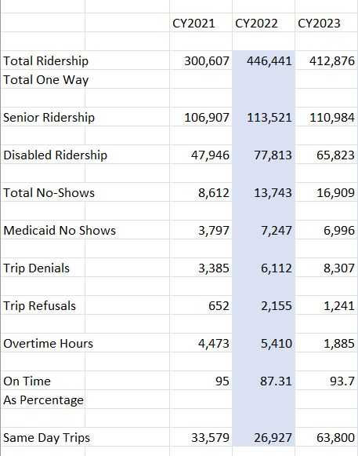
Year to Year Regional Performance Comparison (2021-2023)
Discussion Points:
Do we need to include the number of UNIQUE RIDERS going forward?
High N/S, and high percentage of those are Medicaid.
High trip denials – is this a capacity issue or other?

Slide 31
Consider current unmet needs…
Review, revise, and Create new
Regional Unmet Needs List

Slide 32
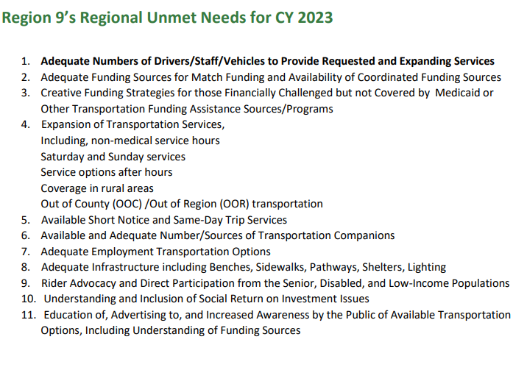
Current Regional Unmet Needs

Slide 33
Step Two: Develop New SWOT
Consider Current SWOT

Slide 34
Consider current SWOT analysis…
Review, revise and create
new Regional SWOT analysis

Slide 35
Current SWOT - Strengths

Slide 36
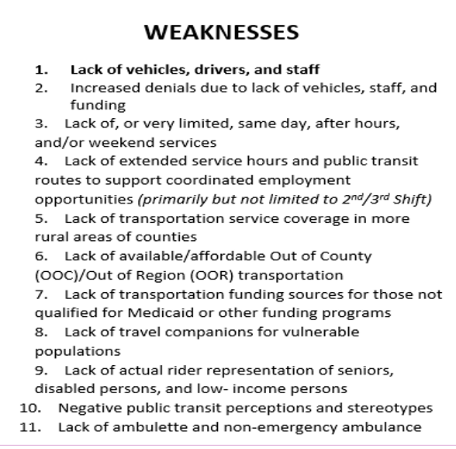
Current SWOT - Weaknesses

Slide 37
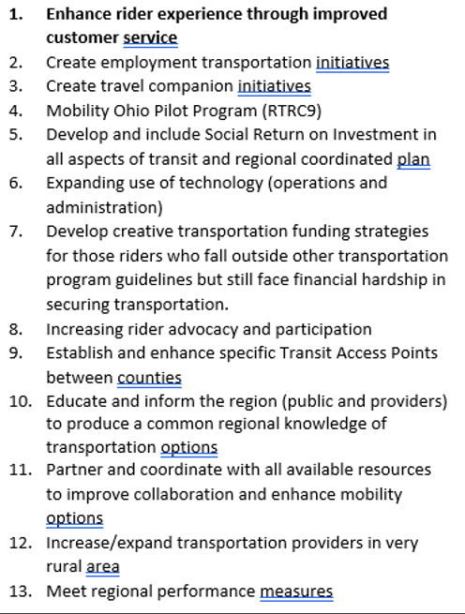
Current SWOT - Opportunities

Slide 38
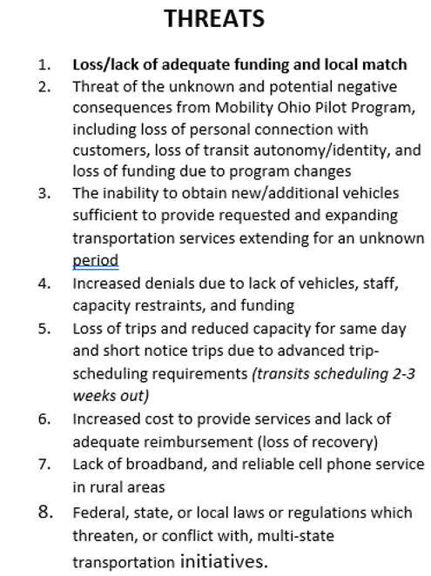
Current SWOT - Threats

Slide 39
FIVE
MINUTE
BREAK

Slide 40
Step Three: Develop New Goals
Consider Current Regional Goals

Slide 41
Consider current Goals…
Review, revise and create new
Regional Goals

Slide 42
Current Region 9 GOALS:
Goal 1: To Maintain and Expand Transportation Services and Options
Goal 2: To Educate and Inform the Public, HHS Agencies and Organizations, and other Stakeholders as to the Transportation Services and Options Available.
Goal 3: To Ensure and Increase Equity, Access, Inclusivity, and Safety in Transportation Services and Options.

Slide 43
Step Four: Develop Strategies for each Goal
Consider Current Strategies

Slide 44
Consider current Strategies to meet the goals….
Review, revise and create new
Regional Strategies

Slide 45
Goal 1: To Maintain and Expand Transportation Services and Options
Strategy 1.1 - Support initiatives for cost effective vehicle replacement, fleet expansion, and needed safety adjustments.
Strategy 1.2 - Increase access to affordable and available employment transportation options.
Strategy 1.3 - Create more affordable, efficient, and available Out of County (OOC)/Out of Region (OOR) transportation.
Strategy 1.4 - Expand service hours of operation and create or expand weekend services.
Strategy 1.5 - Enhance and support the creation and use of regionally beneficial technologies.

Slide 46
Goal 2: To Educate and Inform the Public, HHS Agencies and Organizations, and other Stakeholders as to the Transportation Services and Options Available.
Strategy 2.1 - Support and utilize Mobility Management Program.
Strategy 2.2 - Continue quarterly RCC and monthly Steering Committee meetings.
Strategy 2.3 - Increase marketing and advertising of transportation services and options.
Strategy 2.4 - Enhance and support the use of regionally beneficial technologies.
Strategy 2.5 - Continue annual Origin-Destination (O-D) mapping.

Slide 47
Goal 3: To Ensure and Increase Equity, Access, Inclusivity, and Safety in Transportation Services and Options.
Strategy 3.1 - Continue monthly Steering Committee meetings.
Strategy 3.2 - Build collaborative network of new and existing providers and other stakeholder agencies to promote affordable, available, collaborative regional transportation access for all.
Strategy 3.3 - Support initiatives that promote broadband, cell phone, and internet access, and connectivity, for the region and locally.
Strategy 3.4 - Standardize regional forms, policies, and procedures.
continues next page

Slide 48
Strategy 3.5 - Examine current and alternative fare structures.
Strategy 3.6 - Utilize and promote Region 9 Mobility Solutions Center (MSC)*. *This strategy has been incorporated into the Mobility Ohio pilot project to begin January 2024 in four of our counties. Development of the ODOT pilot project has begun and will continue to develop in CY 2023 building toward implementation in January 2024.
Strategy 3.7 - Create innovative pilot programs (OOC/OOR, volunteer companions, volunteer drivers, innovative fund braiding, media outreach, etc.).
Strategy 3.8 - Establish and maintain infectious disease/Emergency specific responses (COVID, Natural Disasters, Etc.).
Strategy 3.9 - Ensure equity, access, and inclusion for all riders.

Slide 49
HANG IN THERE!
ALMOST DONE!!!
This Photo by Unknown Author is licensed under CC BY-NC-ND

Slide 50
Step Five: Develop Action Items for each Strategy
Consider Current Action Items

Slide 51
Consider current Action Items…
Review, revise and create new
Action Items

Slide 52
Goal 1: To Maintain and Expand Transportation Services and Options
Strategy 1.1 - Support initiatives for cost effective vehicle replacement, fleet expansion, and needed safety adjustments.
Action: Continue to log and document regional vehicle milage, age, and condition and perform appropriate data analysis.
Action: Monitor and share other funding sources for purchasing or leasing transportation service vehicles.
Action: Schedule 5310 Grant Application workshop and assistance.
Action: Research options for introduction of zero emission and electric vehicles into regional fleets.
Strategy 1.2 - Increase access to affordable and available employment transportation options.
Action: Extend or create service hours of transportation to support varying employment schedules, including shift work needs, and transportation beyond the 7am- 5pm M-F hours.
Action: Coordinate with job and career centers, and Ohio Means Jobs, to track employment transportation needs and provide information.
Action: Educate employers about available resources to coordinate employment transportation.
Action: Utilize GOhio Commute platform when available for carpool/vanpool possibilities.
Action: Research and consider micro transit options to provide employment transportation.

Slide 53
Goal 1: To Maintain and Expand Transportation Services and Options
Strategy 1.3 - Create more affordable, efficient, and available Out of County (OOC)/Out of Region (OOR) transportation.
Action: Decrease one person vehicle trips for all providers by coordinating rides especially for OOC/OOR trips.
Action: Research and consider fare capping strategies.
Strategy 1.4 - Expand service hours of operation and create or expand weekend services.
Action: Reduce one person vehicle trips.
Action: Develop best practices of No Show/Cancellation Policies.
Action: Consider fixed route and shuttle service options.
Action: Consider micro transit options.
Strategy 1.5 - Enhance and support the creation and use of regionally beneficial technologies.
Action: Research and develop common or functionally interconnected scheduling software technology to be used throughout the region.
Action: Share scheduling portals with medical providers to effectively schedule medical trips.
Action: Encourage trip reminder calls be made for all riders of scheduled trips.

Slide 54
Goal 2: To Educate and Inform the Public, HHS Agencies and Organizations, and other Stakeholders as to the Transportation Services and Options Available.
Strategy 2.1 - Support and utilize Mobility Management Program.
Action: Continue monthly Regional Council of Mobility Managers meetings.
Action: Continue to include Mobility Managers on Steering Committee.
Action: Support regional Mobility Management coverage for all counties in region.
Action: Encourage strong working relationship between public transits and mobility management.
Strategy 2.2 - Continue quarterly RCC and monthly Steering Committee meetings.
Action: Continue quarterly RCC and monthly Steering Committee meetings.
Strategy 2.3 - Increase marketing and advertising of transportation services and options.
Action: Increase education and awareness with the public, employers, employees and job seekers to available employment transportation services and options.
Action: Increase education and awareness within Stakeholder organizations and the public of equity and access initiatives within transportation services and options.
Action: Build collaborative network of existing HHS and healthcare providers to promote affordable, available, collaborative regional medical transportation access.
Action: Promote the Region 9 Resource Guide.
Action: Host and attend local public workshops and marketing events.
Action: Promote social media opportunities and regional commercials.

Slide 55
Goal 2: To Educate and Inform the Public, HHS Agencies and Organizations, and other Stakeholders as to the Transportation Services and Options Available.
Strategy 2.4 - Enhance and support the use of regionally beneficial technologies.
Action: Utilize the Region 9 Mobility Solutions Center, when available, to function effectively for the whole region. (This has now been encompassed into the Mobility Ohio Pilot Project and the Regional Transportation Resource Center ( RTRC9)
Action: Support, promote, and utilize the Region 9 Resource Guide.
Action: Research possibilities for a regional app that would allow for scheduling and payment of trips.
Action: Coordinate the Region 9 Resource Guide, Region 9 Mobility Solutions Center
(now RTRC9 with Mobility Ohio Pilot), and Regional Survey of Unmet Needs Survey link.
Strategy 2.5 - Continue annual Origin-Destination (O-D) mapping.
Action: Continue to request and map O-D information from transits and transportation providers.

Slide 56
Goal 3: To Ensure and Increase Equity, Access, Inclusivity, and Safety in Transportation Services and Options.
Strategy 3.1 - Continue monthly Steering Committee meetings.
Action: Provide monthly Steering Committee meetings.
Strategy 3.2 - Build collaborative network of new and existing providers and other stakeholder agencies to promote affordable, available, collaborative regional transportation access for all.
Action: Increase County level participation in TAC meetings.
Action: Increase participation and membership in the Regional Coordinated Council (RCC).
Action: Promote the Regional Survey of Unmet Needs.
Action: Meet with each county DJFS individually and in a group.
Strategy 3.3 - Support initiatives that promote broadband, cell phone, and internet access, and connectivity, for the region and locally.
Action: Support OMEGA and ODOT broadband expansion projects in the region.
Action: Advocate for and support initiatives that promote all forms of connectivity issues within the region and locally.
Action: Research funding opportunities available through the Bipartisan Infrastructure Law (BIL).

Slide 57
Goal 3: To Ensure and Increase Equity, Access, Inclusivity, and Safety in Transportation Services and Options.
Strategy 3.4 - Standardize regional forms, policies, and procedures.
Action: Consider regional cost allocation, and billing and rate coordination between transportation service providers and human services agencies. (This is now included in the Mobility Ohio Pilot Project to begin in January 2024 in four of the Region 9 counties)
Action: Promote coordination of one regional DJFS policy, trip requirements, and payment facilitation. (This is now included in the Mobility Ohio Pilot Project to begin in January 2024 in four of the Region 9 counties)
Strategy 3.5 - Examine current and alternative fare structures.
Action: Consider regional fare capping pilot program.
Action: Consider a regional app for scheduling and payment of trips.
Action: Explore possibility and structure of standardized fares across counties.
Action: Consider the possibility of setting regional OOR and OOC rates.

Slide 58
Goal 3: To Ensure and Increase Equity, Access, Inclusivity, and Safety in Transportation Services and Options.
Strategy 3.6 - Utilize and promote Region 9 Mobility Solutions Center (MSC)*.
Action: Maintain Mobility Management participation in all aspects of Mobility Solution Center.
Action: Cross promote the MSC with the Region 9 Resource Guide.
Action: Develop regional Memorandums of Understanding.
Action: Provide regional marketing and other regional support.
*This strategy has been incorporated into the Mobility Ohio pilot project to begin January 2024 in four of our counties. Development of the ODOT pilot project has begun and will continue to develop in CY 2023 building toward implementation in January 2024.
Strategy 3.7 - Create innovative pilot programs (OOC/OOR, volunteer companions, volunteer drivers, innovative fund braiding, media outreach, etc.).
Action: Consider Micro transit pilot program in region or in a regional segment.
Action: Consider EV pilot program.
Action: Consider regionwide transportation pass (Universal Travelers Card for region).
Action: Consider volunteer transportation companions pilot program.
Action: Consider employment transportation routes within or between counties.
Action: Consider and support multi-county coordinated programs.
Action: Develop “transfer points” between counties for coordinated trips.

Slide 59
Goal 3: To Ensure and Increase Equity, Access, Inclusivity, and Safety in Transportation Services and Options.
Strategy 3.8 - Establish and maintain infectious disease/Emergency specific responses (COVID, Natural Disasters, Etc.).
Action: Monitor and implement ODOT, FTA, and TSA directives as they are issued.
Strategy 3.9 - Ensure equity, access, and inclusion for all riders.
Action: Continue to survey and monitor needs, unmet needs, and satisfaction of riders in the region.
Action: Support active transportation initiatives.
Action: Consider new ways to access underserved populations and transportation desert areas.

Slide 60
DEEP BREATH – WE SURVIVED

Slide 61
Meeting Calendar for 2024
Meetings are 9am - 11am
February 21, 2024 RCC/SC- AAA9 Offices (9-noon)
March 20, 2024 Steering Meeting
April 17, 2024 Steering Meeting
May 15, 2024 RCC Meeting
June 19, 2024 Steering Meeting
July 17, 2024 Steering Meeting
August 21, 2024 RCC Meeting
September 18, 2024 Steering Meeting
October 16, 2024 Steering Meeting
November 20, 2024 RCC Meeting
December 18, 2024 Steering or RCC only if needed
Typically, Steering Committee meetings are held at ODOT District 11 offices in New Philly and RCC meetings “travel” throughout our region and include a lunch invitation. Meeting materials, locations and agendas are sent at least one week in advance of the meeting. VOLUNTEERS TO HOST the 2024 RCC Meetings are welcome, and much appreciated!!

Slide 62
For the Good of the Region, Announcements and County Updates
Kevin Buettner has left OMEGA and taken the position of Transportation Planning Director at Belomar MPO. His contributions to OMEGA and the communities we serve were many, and he will be missed. We wish him all the best in his new role.
Nicki Silver has left the position of Mobility Manager for Muskingum and Guernsey counties. She has accepted the position of Pediatric Case Manager at MVHC
(Muskingum Valley Health Centers). Her accomplishments were great and included a wheelchair ramp project which helped many. There are no plans currently to replace her position which was housed at SEAT.
SEA (Society for Equal Access) welcomes Ada Mears as the new director. She is currently working three days a week as her health issues continue to improve. Kevin Hannahs retired as director earlier this year and we hope he enjoys his retirement.
Horizons is in critical jeopardy of suspending services. This will be highly impactful as they are the only transportation providers with service in the evening in Tuscarawas County.
Other announcements?

Slide 63
Thank you for the privilege of your time.
Meeting slides, minutes, and related documentation can be accessed here: https://omegadistrict.org/programs/transit/rcc/
Contact information: Deborah Hill, MBA
Regional Transit and Mobility Programs Coordinator
Phone: (740) 439-4471 office
(330) 383-2252 cell
Email: dhill@omegadistict.org
This Photo by Unknown Author is licensed under CC BY-SA
Notes:
MOTION TO ADJOURN

