Slide 1
Voinovich School of Leadership and Public Service
presents
SROI Final Report for OMEGA Regional Public Transit and Transportation Providers
Mandy White
Impact Analyst
whitea5@ohio.edu

Slide 2
SROI analysis for OMEGA Regional Transportation
Social Return on Investment (SROI) is a framework for calculating and communicating social impact using the universal language of money. SROI measures the social value created by an organization’s activities by including social, economic, and environmental impacts in a total measure of social value.
FOR EVERY $1 INVESTED
OMEGA Transportation and Transit GENERATED
$5.43 - $9.13
OF SOCIAL VALUE
This dollar amount reflects the ripple effects created by transportation providers in the OMEGA region
Voinovich School of Leadership and Public and Service

Slide 3
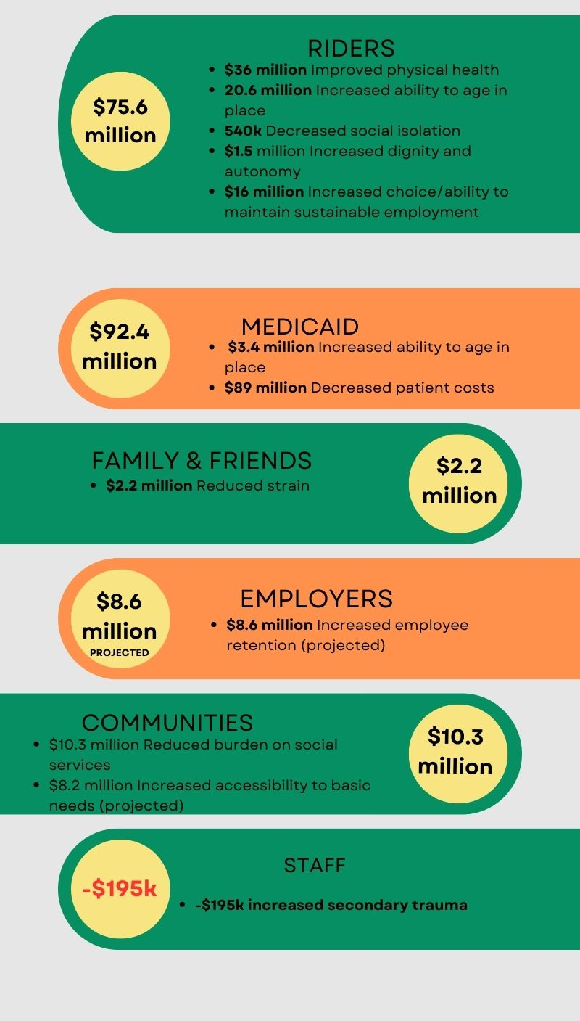
*Before sensitivity analysis and discounting is applied
Voinovich School of Leadership and Public and Service

Slide 4
What does this report do?
Presents the issue behind each outcome
Contextualizes the issue/outcome regionally
Offers regional survey data
Explains OMEGA’s current contribution
Monetizes the value of that contribution
Voinovich School of Leadership and Public and Service

Slide 5
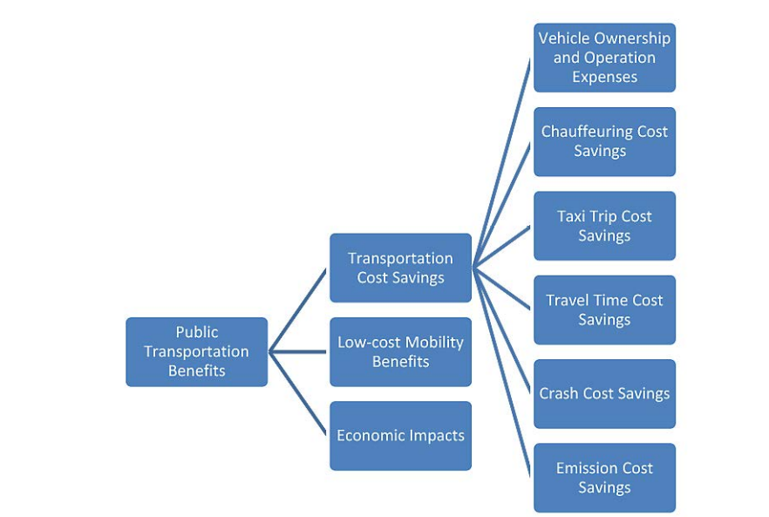
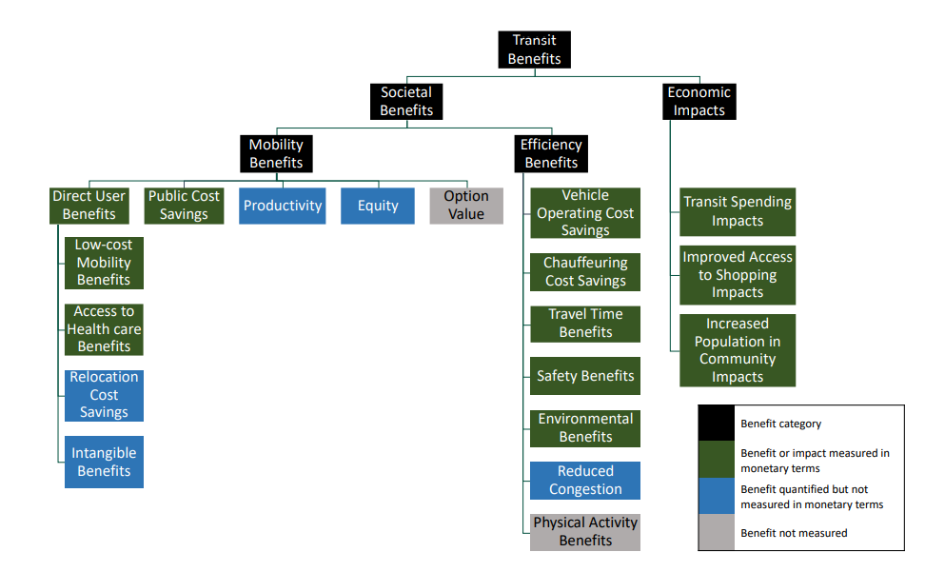
How does this report differ from other transportation benefits analyses?
Typical Transit Assessment Benefits Trees
Voinovich School of Leadership and Public and Service

Slide 6
How does this report differ from other transportation benefits analyses?
Social Benefits
STAKEHOLDERS
Riders
STAKEHOLDERS
Community
STAKEHOLDERS
Riders’ Families
STAKEHOLDERS
Staff
Increased health outcomes
Reduced social isolation
Increased dignity & autonomy
Increased accessibility to basic needs
Decreased health due to exposure to secondary trauma
Reduced strain
Increased ability to age in place
Reduced burden on social services
Reduced fiscal and opportunity costs
Increased choice and sustainability
STAKEHOLDERS
Medicaid
Increased ability to age in place
Reduced patient costs
OMEGA Region Transit and Transportation SROI
Benefits Assessment Tree
Voinovich School of Leadership and Public and Service

Slide 7
How does this report differ from other transportation benefits analyses?
Traditional analyses
Results showed cost-benefit ratios of $2.16 for small urban transit ($2.60 for fixed route and $.64 for demand-response) and $1.12 for rural transit. “Though demand-response service is not found to have a high benefit-cost ratio, these services are considered to be very critical to the community to meet the mobility needs of the transportation disadvantaged.”
National Center for Transit Research
Cost-Benefit Analysis of Rural and Small Urban Transit
July 2014
SROI
FOR EVERY $1 INVESTED
OMEGA Transportation and Transit GENERATED
vs.
$5.43 - $9.13
OF SOCIAL VALUE
Voinovich School of Leadership and Public and Service

Slide 8
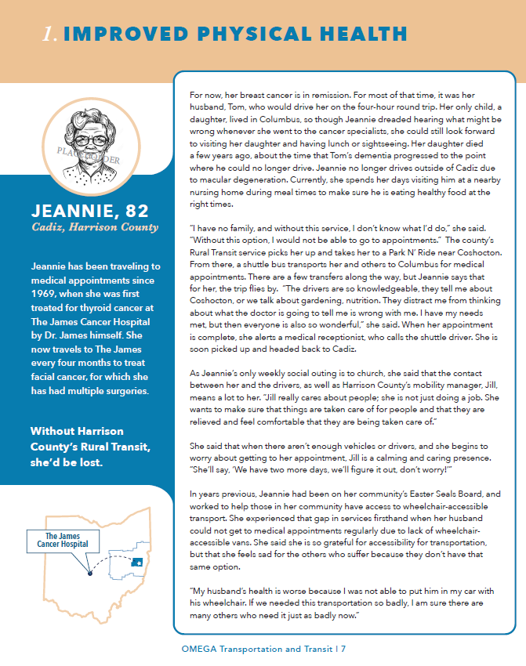
Report Contents
Vignette
Voinovich School of Leadership and Public and Service

Slide 9
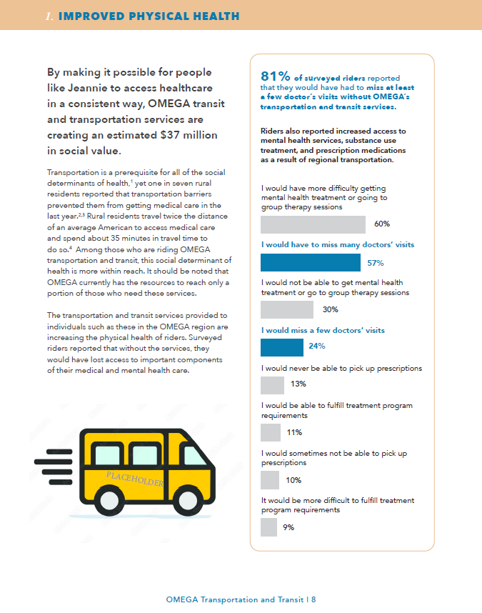
Report Contents
Narrative
Voinovich School of Leadership and Public and Service

Slide 10
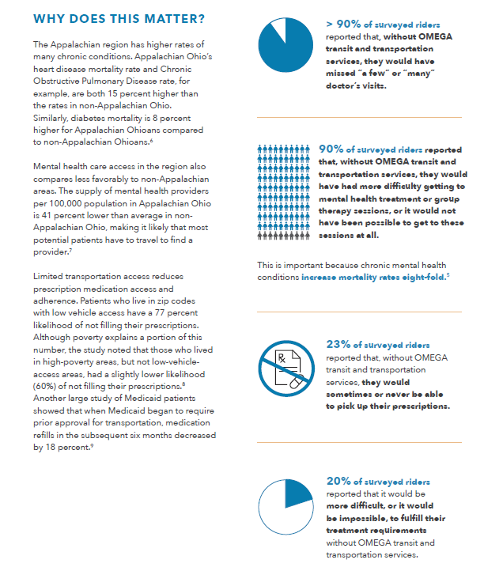
Report Contents
Why Does This Matter?
Voinovich School of Leadership and Public and Service

Slide 11
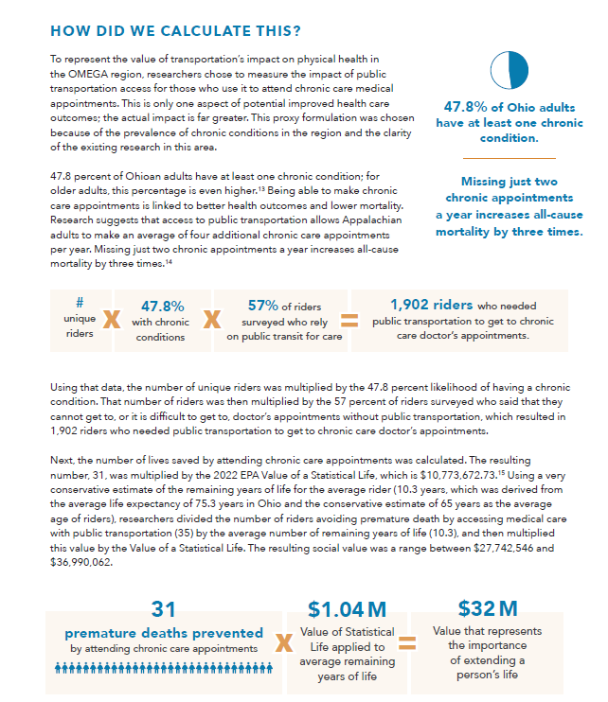
Report Contents
How Did We Calculate This?
Voinovich School of Leadership and Public and Service

Slide 12
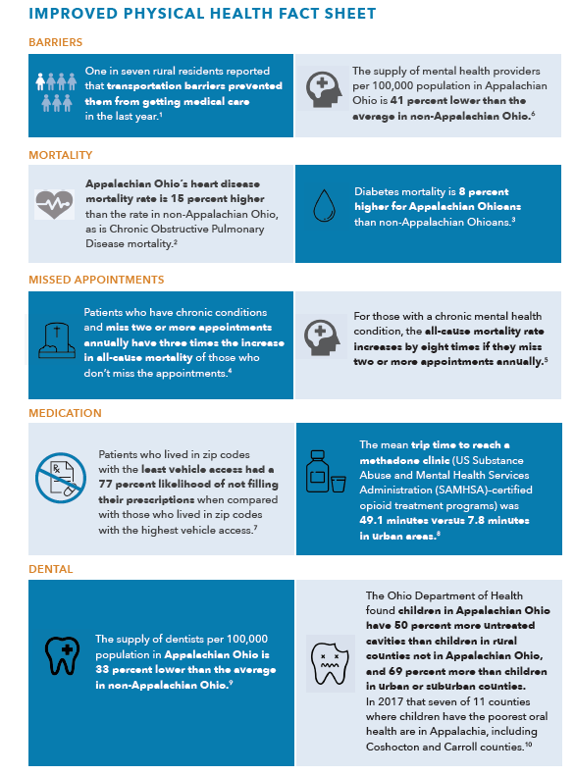
Report Contents
Fact Sheet
Voinovich School of Leadership and Public and Service

Slide 13
How can I use the SROI Report and Impact Calculator?
Internal Impact Management Are we measuring the right things? Are the impacts where we expect them to be? Knowing what we now know, what new questions do we have?
External Communication Where is the information in the report and how do we use it? How do I explain the SROI ratio and what an SROI is? How do we use this report to approach potential funders?
Transparency to Stakeholders What are strategies to share SROI results with your riders and your communities to demonstrate accountability and value for money?
Voinovich School of Leadership and Public and Service
Notes:
For you: It’s really good! You are currently providing AMAZING value to taxpayers
For your funders: If they were investing the same $ in the stock market, they’d be over the moon with their returns!
For your gap in capacity: If Ohio invested $16 per capita (the national average) instead of $6 per capita in its public transportation, it would see amazing impact!

Slide 14
Internal Impact Management
Are we measuring the right things?
Most used survey data
# unique riders
# of older adult riders (derived from % of survey respondents who provided age)
% of those who said they would definitely lose their job without their current transportation provider
% of respondents who said they would have to move to an institutional facility without their current transportation access
Voinovich School of Leadership and Public and Service

Slide 15
Internal Impact Management
Are the impacts where we expect them to be?
Note: Impacts on staff are not included because of their negative value
Medicaid high value
Medicaid low value
Voinovich School of Leadership and Public and Service
Notes:
Families – that number could be much larger – we had to induce it from existing numbers. We could only project employee numbers. Knowing that gap would be very valuable

Slide 16
Internal Impact Management
Measurement Recommendations
Existing data
Annual regional survey
Better understand gap between capacity and regional need; opportunity to identify caregivers
Regional Performance Measures Data
Include unique riders and find way to categorize them into existing subgroups: seniors, those living with a disability etc.
Operational budget makes a SROI ratio possible
New data
Intake survey: Consider intake surveys for new riders for more accurate data with a more manageable load for employees.
Besides medical appointments, where would they ride if they could? Work, school, errands, socialization?
Collaborate with those already getting data: Local hospitals and social services in your community may already be collecting data that is of use. What kind of costs are they incurring due to lack of transportation? What impacts are they experiencing? How many clients are not getting services or meeting basic needs due to transportation? What data do they track?
Voinovich School of Leadership and Public and Service

Slide 17
Internal Impact Management
What new questions do we have?
In going through this process, organizations often:
Prioritize additional outcomes
Isolate elements of existing outcomes and refining those outcomes
Have questions that current data doesn’t answer
Examples:
Prioritize additional outcomes: Impact on regional hospital systems/medical providers’ offices/nursing homes
Refine existing outcomes: Medicaid outcomes (dialysis vs. diabetes etc.)
How many additional rides a week would your current riders take if there was capacity?
What data is going to be of greatest use to Medicaid? To your local funders?
What partnerships could you create by offering your data/collecting data?
Voinovich School of Leadership and Public and Service

Slide 18
External Communication
Finding information in the report
Proxy explanation: Use the Proxy Illustration and How We Calculated This. For the full details, look at Technical Documentation.
Research for grants/one-pagers/policy : Look at the Fact Sheet for each outcome. The Report Narrative may also have useful wording.
Personal stories: Vignettes are at the beginning of each outcome section.
Regional data: Look at Survey Graphs in the Report Narrative. For the full survey, look at the Impact Calculator Dashboard.
SROI ratio and definition: Look in the Introduction.
Stakeholder Recommendations: These are found in the Conclusion.
Consulted or Recommended Sources: Full citations for the Proxy Research are in the final pages of the Technical Report. Fact Sheets and the Report Narrative are also fully cited.
Voinovich School of Leadership and Public and Service

Slide 19
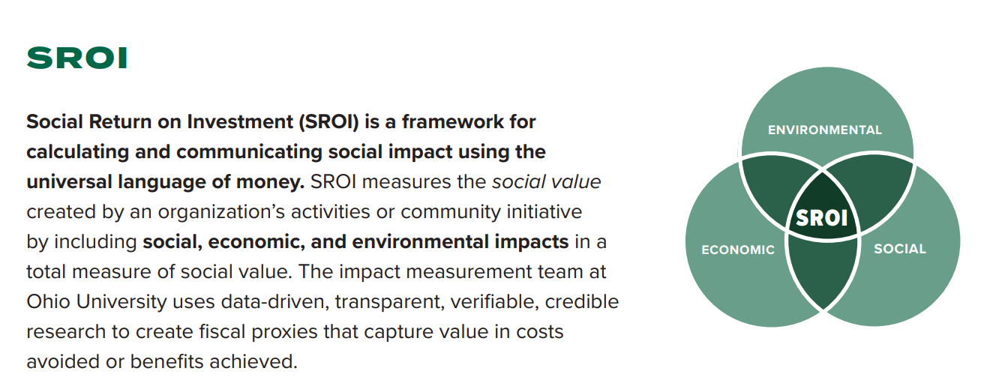
External Communication
How do I explain an SROI to others?
SROI is a cutting-edge methodology in the US and may require different levels of definition and explanation, depending on the audience and the medium. Here is the “elevator pitch” version of SROI, for inclusion in materials and explanations. Look in the Introduction for a more detailed description. The Technical Documentation has the most complete discussion of methodology.
Voinovich School of Leadership and Public and Service

Slide 20
External Communication
Who do I share results with?
Recommendation: Create a strategy and a deliverable for the following groups
Lobbyists and Advocacy Groups
Local Nonprofits
Existing Stakeholders
Potential Stakeholders and Partners
Local Politicians (County Commissioners, City Councils)
Current Funders
Potential Funders
Voinovich School of Leadership and Public and Service

Slide 21
External Communication
Policy Brief
Title Example: ”OMEGA-region transit/transportation providers saved [Stakeholder] $X million last year. Millions more in savings are possible.”
Executive Summary: One to two paragraphs; problem + proposed policy action. Include the SROI ratio or individual outcome proxy value here.
Context or Scope of Problem: Explain the importance of the problem – look to Fact Sheet or “Why This Matters” section of the narrative for a starting point. No more than a few facts and one paragraph total.
Policy Alternatives: Discusses the current policy approach, i.e. chronic underfunding, and explain proposed options. Explain why additional funding = additional return on investment.
Policy Recommendations: This section contains the most detailed explanation of the concrete steps to be taken to address the policy issue. What do you need and when do you need it?
Consulted or Recommended Sources: Use the report or proxy citations.
Voinovich School of Leadership and Public and Service

Slide 22
External Communication
One-Pagers Formula
1. About Us/Summary
One sentence describing your organization.
2. The Problem Statement
Included in “Why this Matters.” Use only the pieces of this section that really make your point. One or two sentences.
3. Features or Benefits
Included in the “How Does OMEGA…” section.
4. Use Proof
Include the SROI Ratio and Outcome number graphics.
5. Include a Call-to-Action
Include a clear call-to-action at the end. If your goal is local match, explain why local match is so vital and end with, “Your donation of $X as local match could also have a return on investment for your community of $X.”
Voinovich School of Leadership and Public and Service

Slide 23
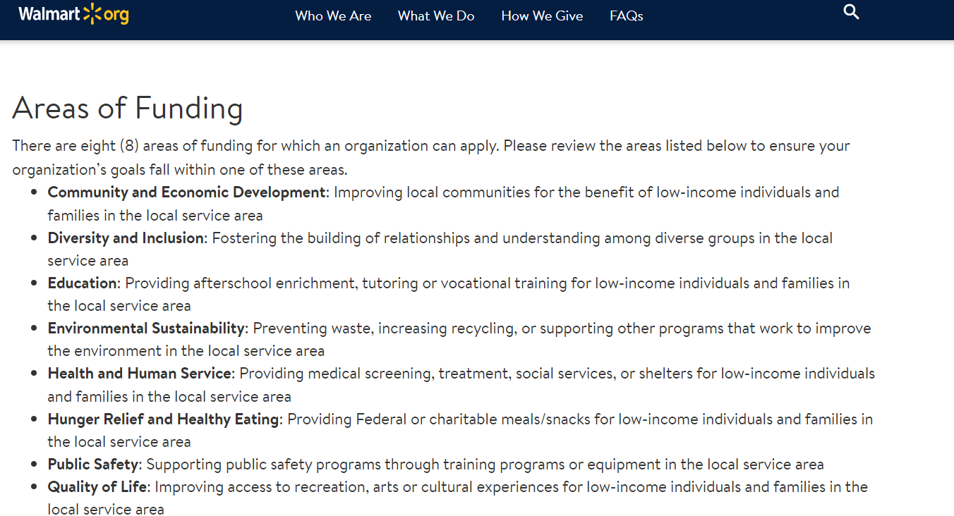
External Communication
Grants
Potential areas
of focus
Increased physical health
Increased ability to age in place
Increased choice/ability to maintain sustainable employment
Decreased social isolation
Increased ability to age in place
Increased access to basic needs
Decreased social isolation
Increased ability to age in place
Increased access to basic needs
Increased physical health
Reduced strain on families
Decreased social isolation
Increased ability to age in place
Increased access to basic needs
Reduced strain on families
Voinovich School of Leadership and Public and Service

Slide 24
Transparency to Stakeholders
Strategies to share SROI results
SOCIAL MEDIA
CAMPAIGN
Voinovich School of Leadership and Public and Service

Slide 25
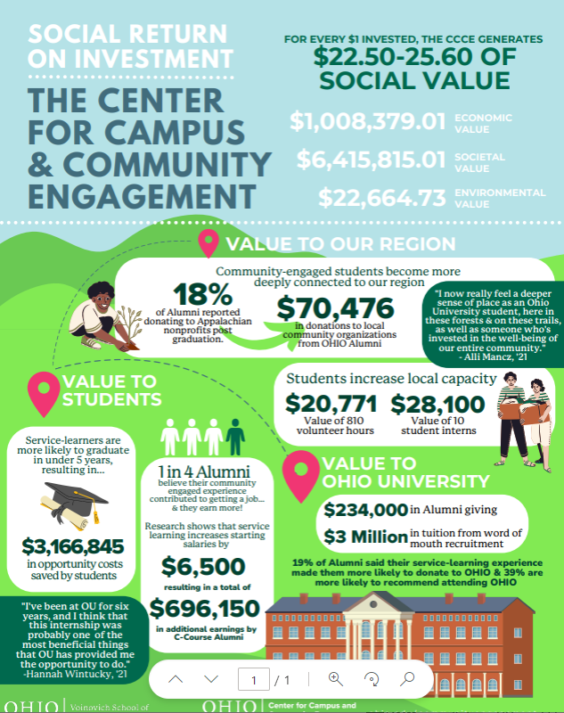
Transparency to Stakeholders
Strategies to share SROI results
INFOGRAPHIC
Voinovich School of Leadership and Public and Service

Slide 26
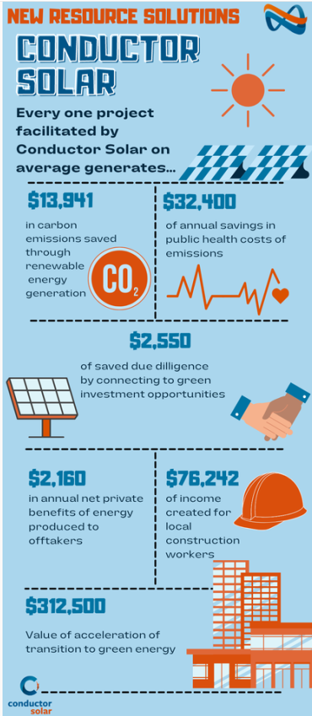
Transparency to Stakeholders
Strategies to share SROI results
INFOGRAPHIC
Voinovich School of Leadership and Public and Service

Slide 27
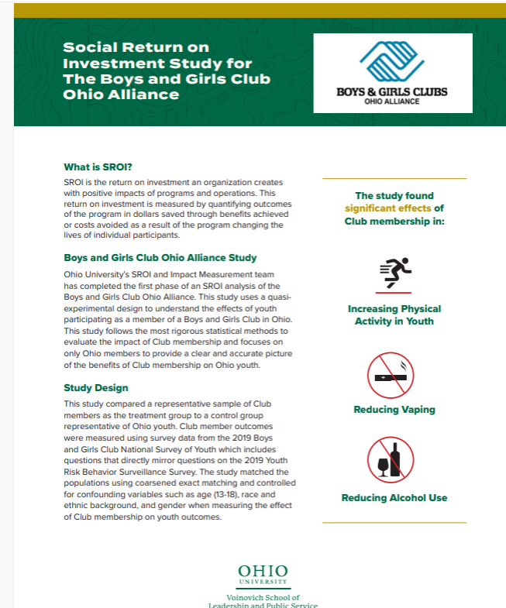
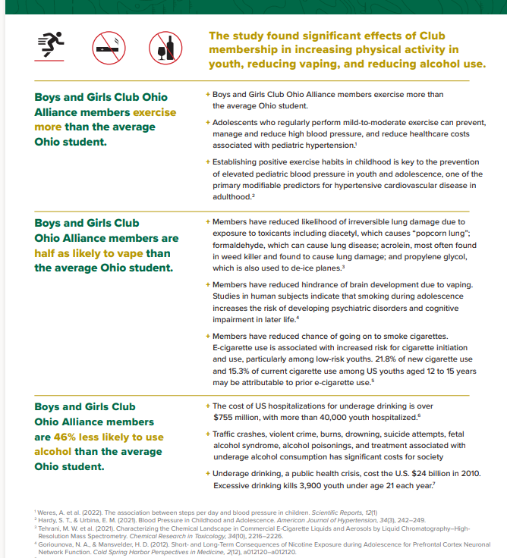
Transparency to Stakeholders
Strategies to share SROI results
ONE PAGER
Voinovich School of Leadership and Public and Service

Slide 28
Transparency to Stakeholders
Strategies to share SROI results
VIDEO
Fit to Navigate Video
Voinovich School of Leadership and Public and Service

Slide 29
Recommendations
For local communities and funders: Each year, regional transportation agencies struggle to find local matching funding, which helps to secure funding for vehicles, mobility managers, and rides for individuals with low incomes. Increasing support for local funding match for transportation would increase capacity, which would further increase social impact.
For employers: Collaboration between employers and local transportation providers, including possible employee-funded transportation options for employees, may attract more employees and decrease employee absenteeism and turnover costs.
For Medicaid: Non-emergency medical transportation provides a strong social return on investment that would be able to support reimbursement for actual trip costs, and reimbursement for trip no-shows or last-minute calculations.
For caregivers: Advocating on a local level for strengthening local transportation through increased funding and awareness will help to ensure the availability of an important resource to help alleviate the substantial burden on many caregivers.
Voinovich School of Leadership and Public and Service

Slide 30
Conclusion
Full report will available by request after feedback is incorporated.
One pagers will be finished in February 2024.
FOR EVERY $1 INVESTED
OMEGA Transportation and Transit GENERATED
$5.43 - $9.13
OF SOCIAL VALUE
Voinovich School of Leadership and Public and Service

